Slide 1


Data analysis on
Uber Fare Dataset
Presenter： Jiayu Cui & Yanqi Yu

Slide 2
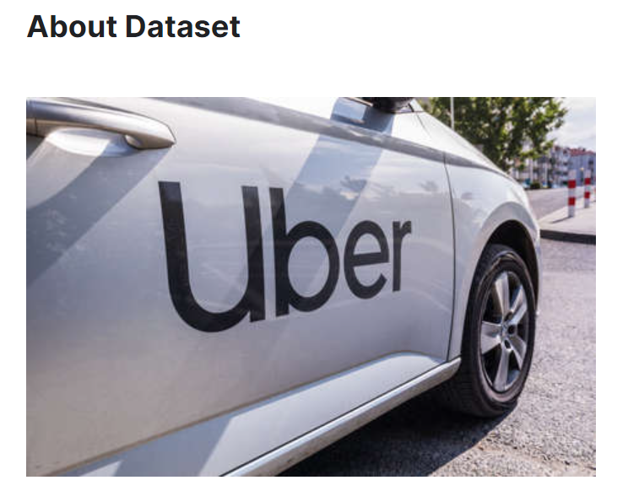
Dataset Introduction
Description:
The project is about the world's largest taxi company Uber Inc. In this project, we're looking to predict the fare for their future transactional cases.

Slide 3
Dataset Introduction
The dataset contains following values:
fare_amount : the cost of each trip in usd
pickup_datetime : date and time when the meter was engaged
passenger_count : the number of passengers in the vehicle
pickup_longitude, pickup_latitude, dropoff_longitude ,dropoff_latitude

Slide 4
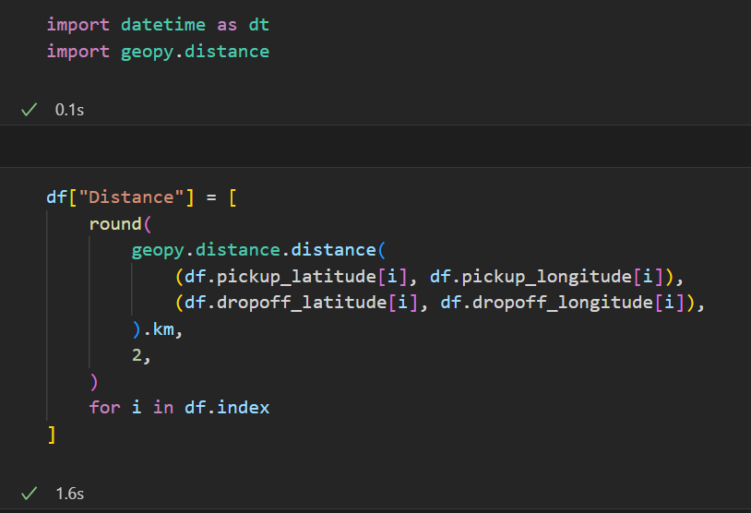
Dataset Preprocessing
添加主题
Calculate the distance based on the given latitude and longitude

Slide 5
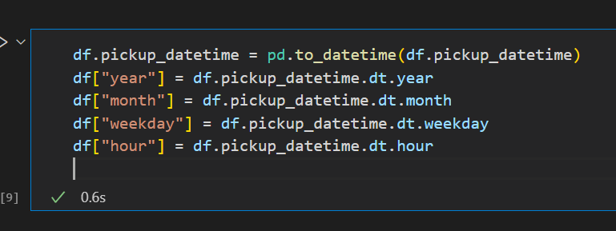
Dataset Preprocessing
Retrieve the specific time data

Slide 6
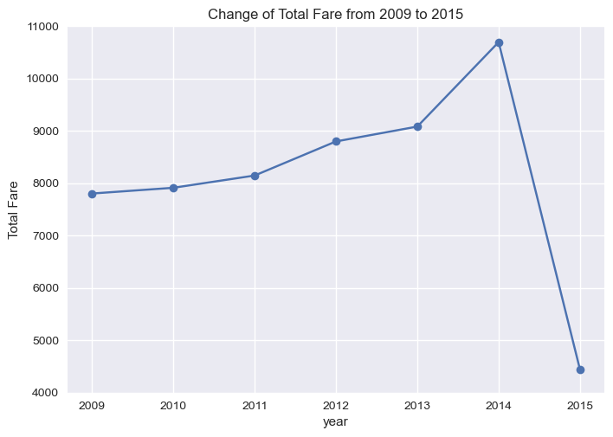
Dataset Analysis
Q1:Change of Total Fare from 2009 to 2015
A steady increase with a sudden fall in 2015

Slide 7
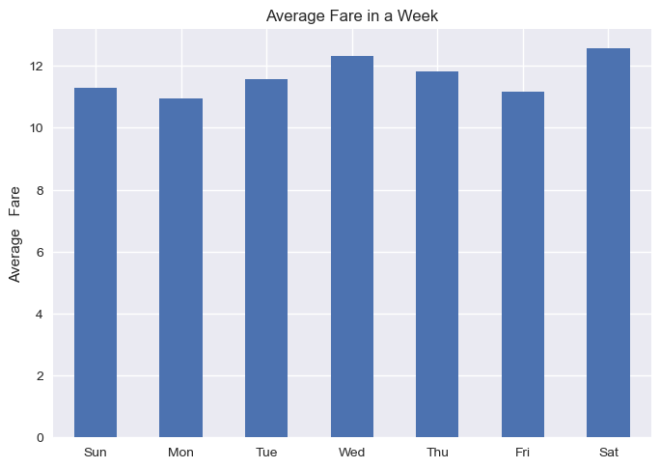
Dataset Analysis
Q2:Distribution of Average Fare in a week and in which day the average fare is the highest
Evenly distributed in general
Slightly more in Saturday and Wednesday

Slide 8
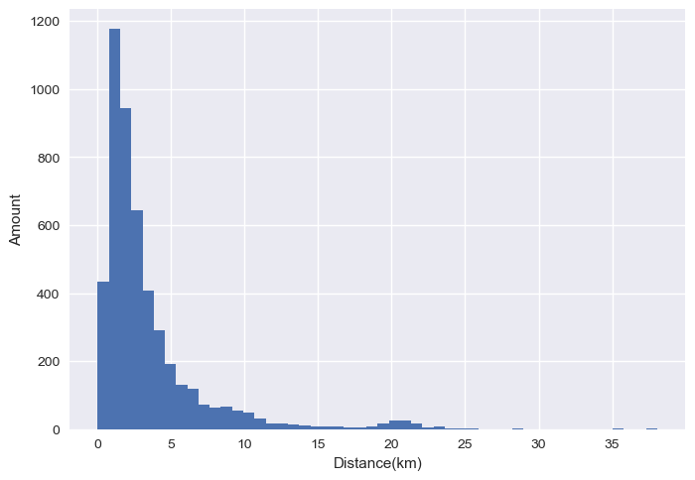
Dataset Analysis
Q3:Distribution of distance of each trip
The data are concentrated on short trip (0-5 km)

Slide 9
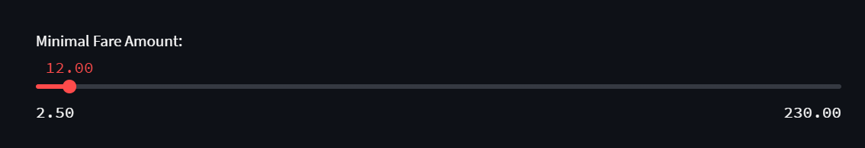
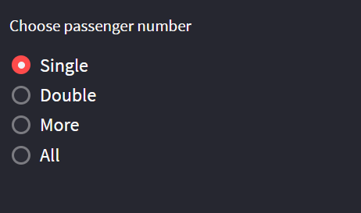
Interactive widgets
 By using the interactive widgets( the slider and sidebar), we are able to analyze the relationship between the distance and order amount distribution of Uber trips and the number of passengers

Slide 10
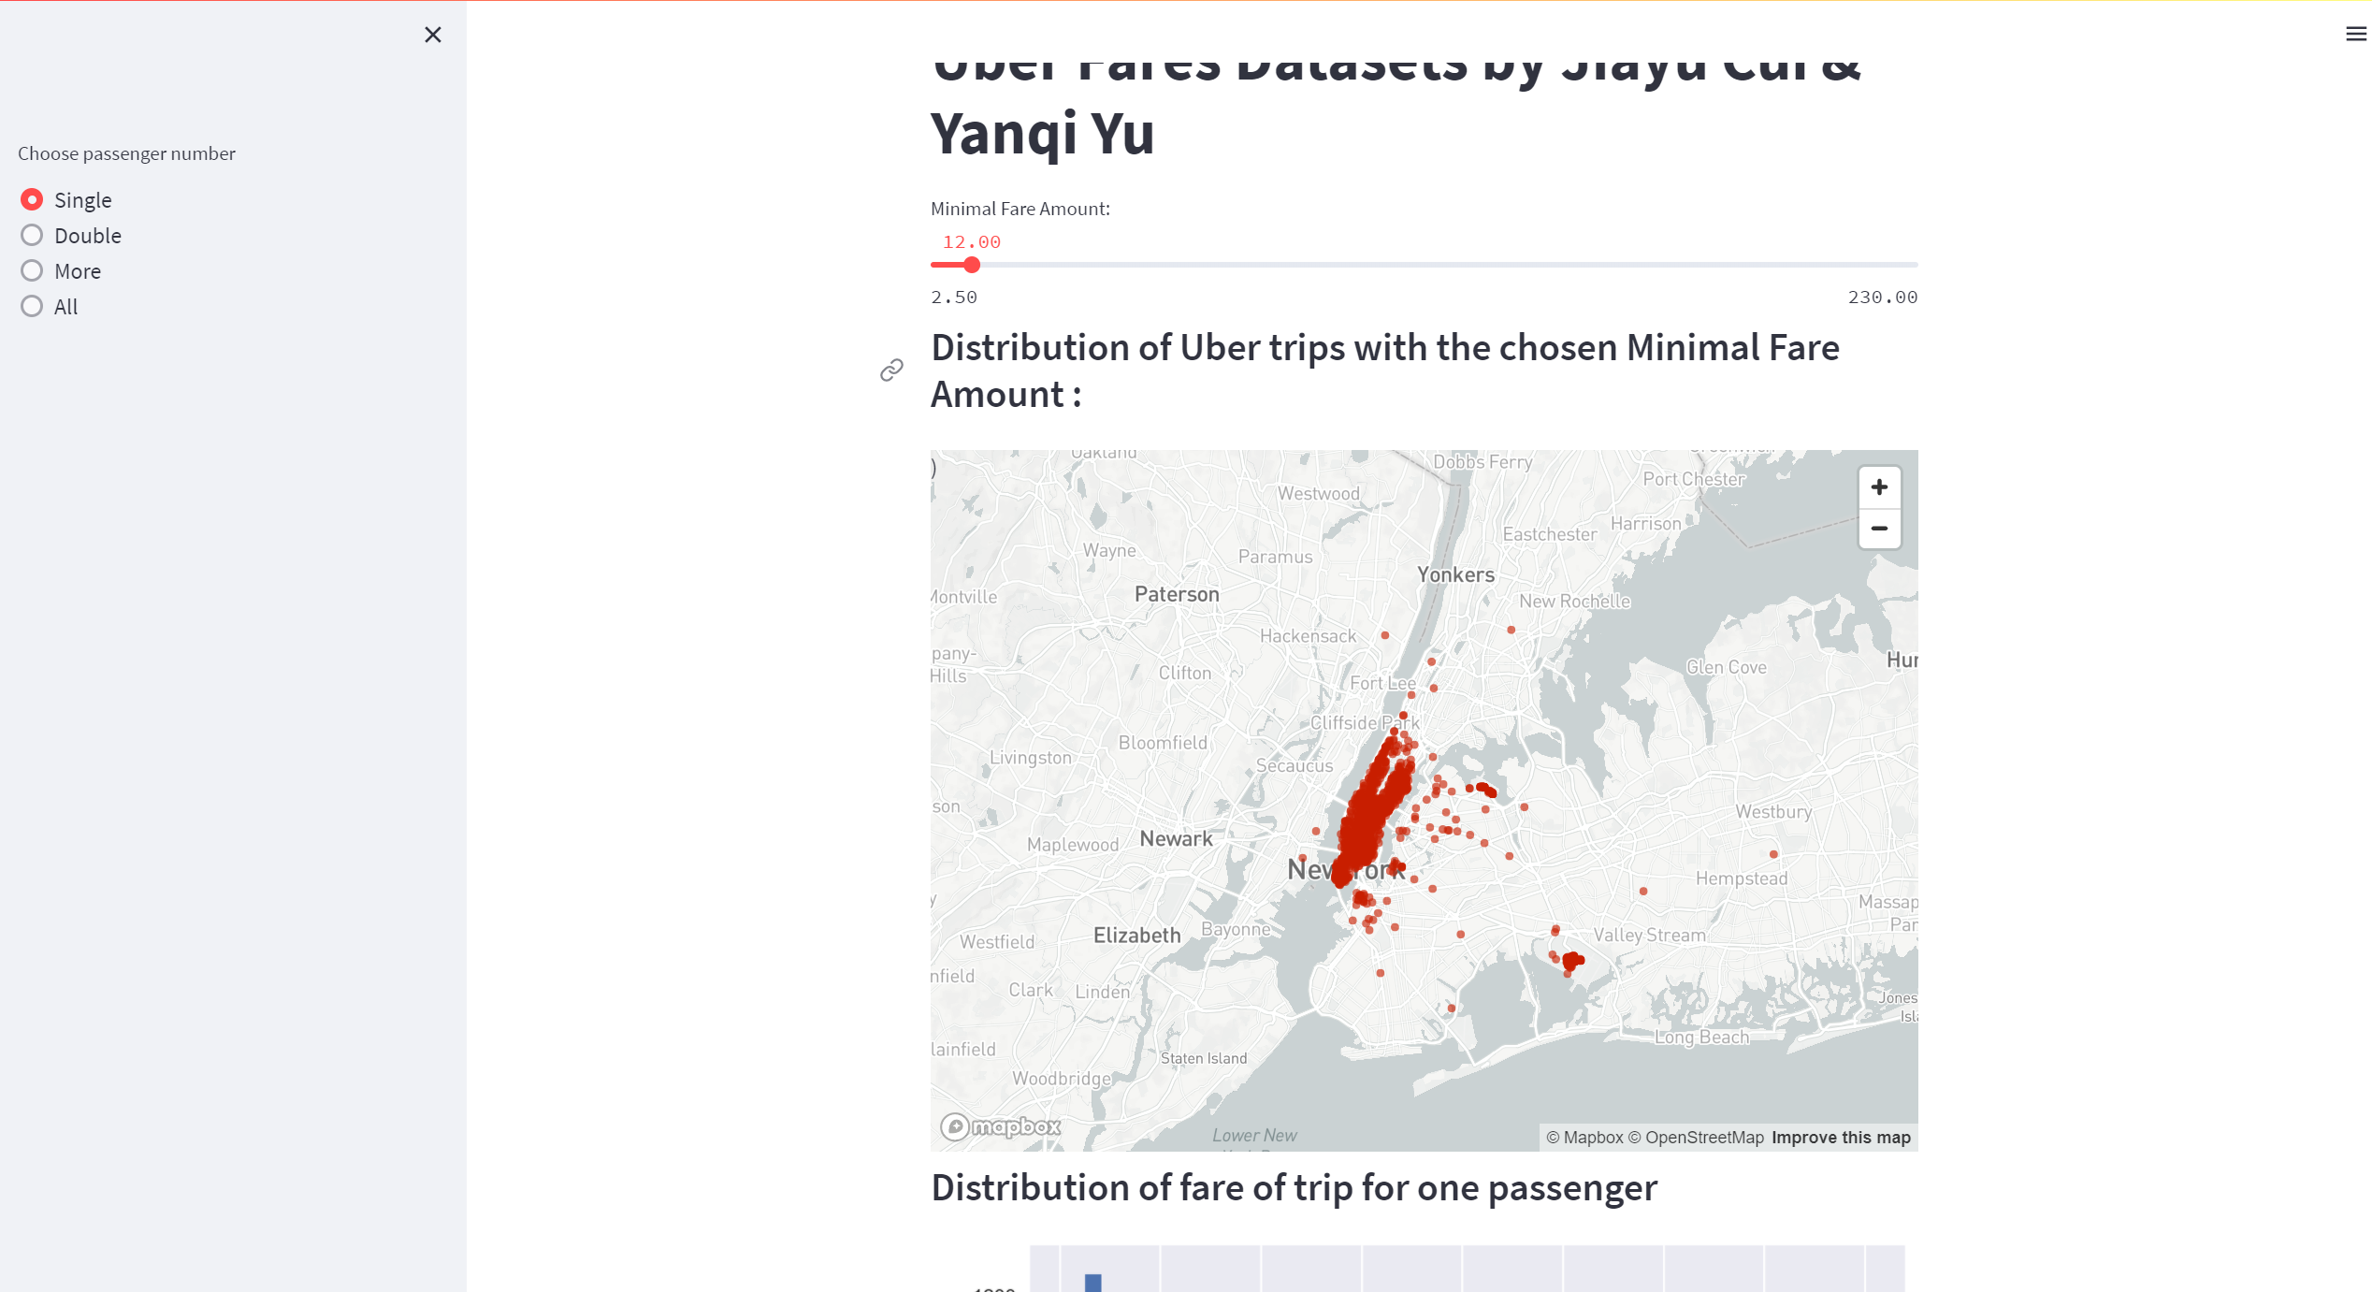
Dataset Conclusion
 The greater the number of passengers,
the greater the distance per trip, and the more expensive the Uber fare, indicating that people prefer to carpool with other passengers for economic reasons when taking long-distance rides.

Slide 11
Thanks for listening

